Slide 1


FOREIGN DIRECT INVESTMENT ANALYTICS
PRESENTED BY : SHILPA NAGPAL

Slide 2




INTRODUCTION
FOREIGN DIRECT INVESTMENT (FDI)
Foreign Direct Investment (FDI) involves a firm or individual from one country investing in business interests in another country, often by establishing business operations or acquiring business assets. FDI differs from portfolio investment due to the investor's significant ownership and control over the foreign entity.
Key types of FDI include horizontal (same industry), vertical (related industries), and conglomerate (unrelated industries). Motivations for FDI include accessing new markets, securing resources, and benefiting from favorable economic conditions abroad.

Slide 3

PROBLEM STATEMENT
Investment is a game of understanding historic data of investment objects under different events but it is still a game of chances to minimize the risk we apply analytics to find the equilibrium investment.
To understand the Foreign direct investment in India for the last 17 years from 2000-01 to 2016-17. This dataset contains sector and financial year-wise data of FDI in India Sector-wise investment analysis Year-wise investment analysis.
Find key metrics and factors and show the meaningful relationships between attributes. Do your own research and come up with your findings
PROJECT TITLE | Foreign Direct Investment Analytics
TECHNOLOGY | Data Science
DOMAIN | Finance
PROJECT DIFFICULTY LEVEL | Intermediate
PROGRAMMING LANGUAGE USED | Python
TOOLS USED | Jupyter Notebook, MS-Excel, Tableau

Slide 4

ARCHITECTURE
Raw data Collection
Importing Libraries in Jupiter Notebook
Load dataset
Missing Values imputations
Handling outliers
Data Cleaning
Exploratory Data Analysis (EDA)
Modelling
Tableau Public Desktop
Insights
Reporting

Slide 5
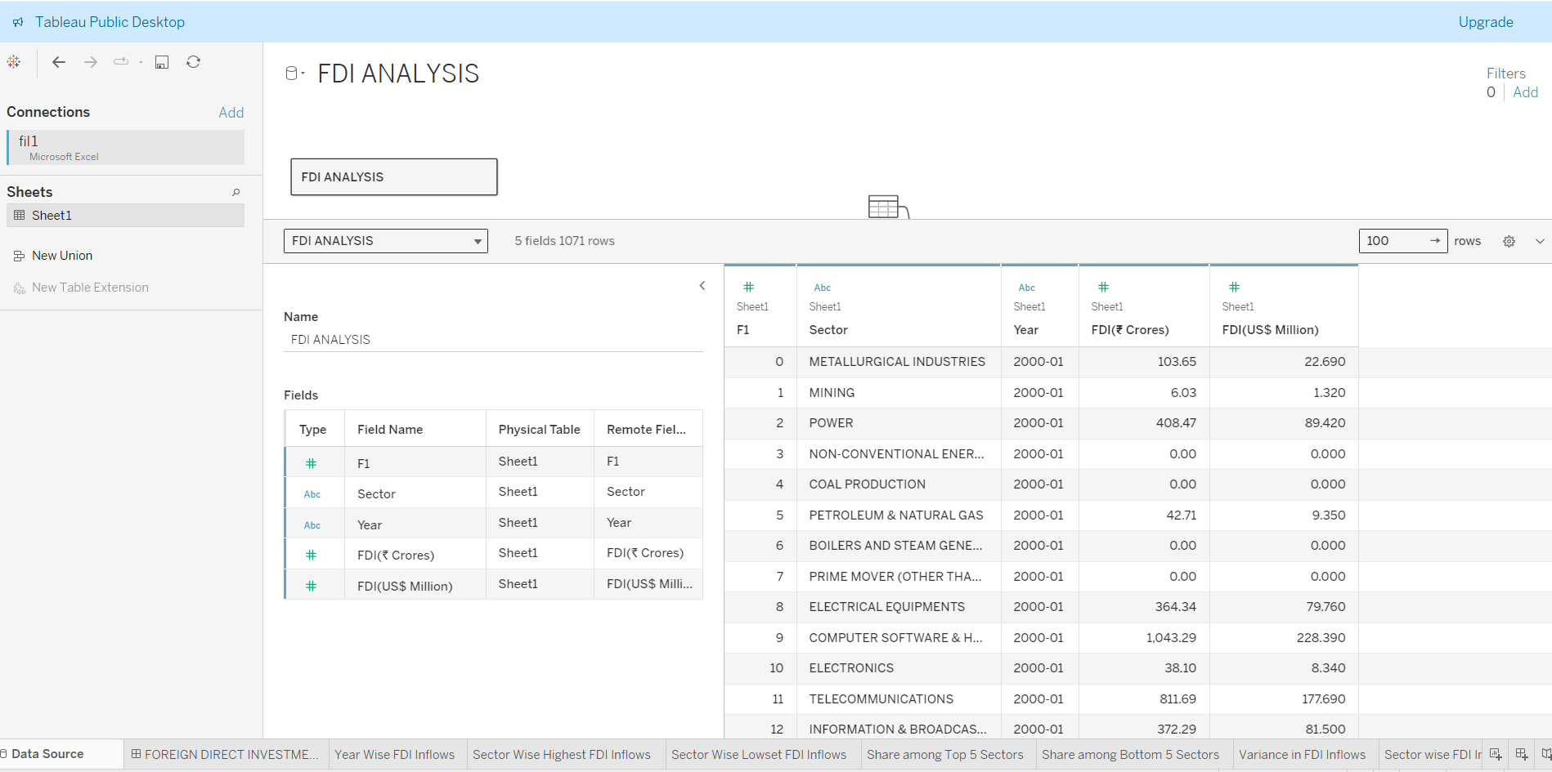
DATA SOURCE

Slide 6
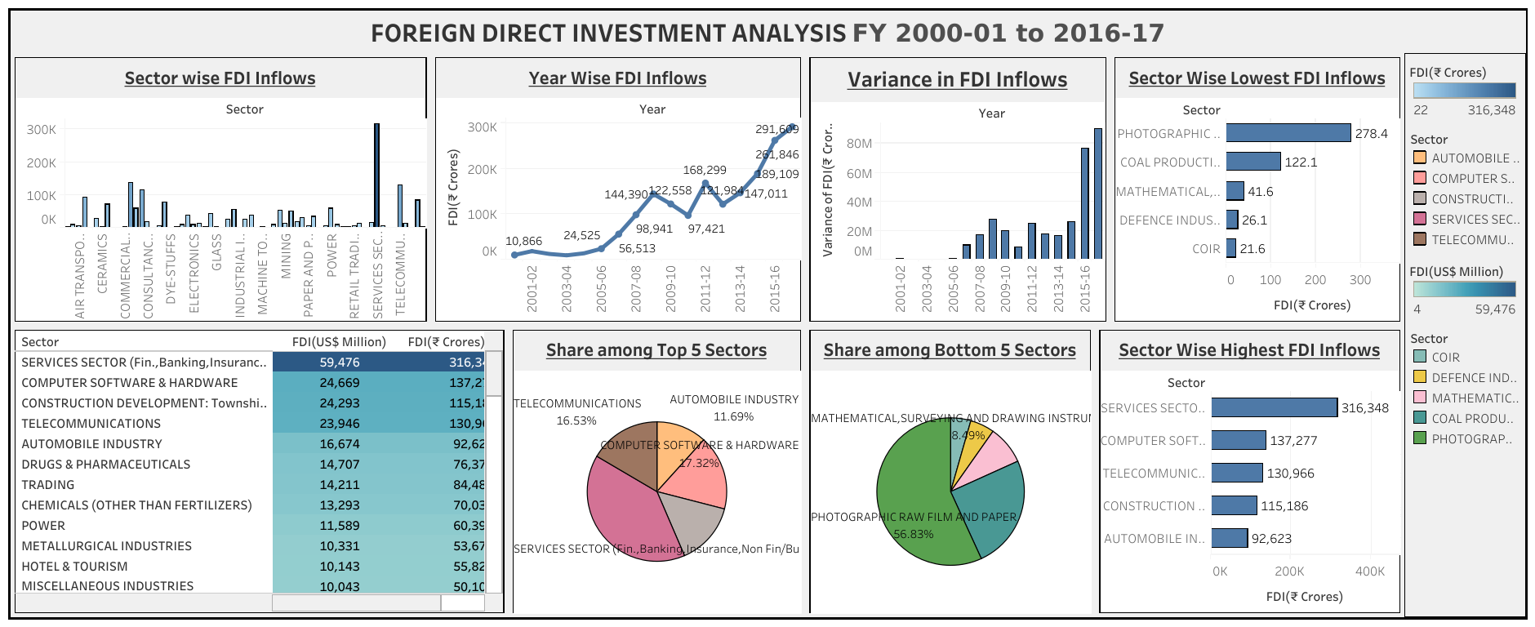
MY DASHBOARD

Slide 7
INSIGHTS GENERATED
The Sectoral composition of FDI over the period of April 2000 to June 2017, we can find that the largest recipient of such investment is service sector (Financial and non-financial services).
The share of this sector in FDI flows is 17 % of the inflow total foreign direct investment.
The foreign investors are interested in mainly financial services due its profit generating advantage. This sector gives scope for the foreign investor to takes back the profits to the home country.
As service sector the services are consumed in the host country and there by generating outflow of funds from the host country.
The second recipient is Computer software and hardware which shares 7% of total FDI. Telecommunication,, Construction Development , Automobile industry, Trade, Drugs and pharmaceuticals, Chemical ( Other than Fertilizers),Power, Construction, Hotel and tourism contribute around 7%,6%, 5%, 4.7%, 4%, 4%, 3%, 3%.
There is very low interest towards sectors like Coir, Defence Industries, Mathematical, surveying
and drawing Instruments, Coal Production and there are around 28 to 30 sectors where share
is less than or equal to 1%.
In 2000-01, no investment was made in 23 out of the 63 sectors, which is the highest number of
sectors with no investment in any year.
Out of the 63 sectors, the average investment was less than 100 in 36 sectors.
The market recession in 2008-09 resulted in significant losses for investors, but these losses were
covered by 2011-12.

Slide 8




Thank You !

